Slide 1
Case study Doing web-based data analytics with F#
Tomas Petricek Don Syme University of Cambridge Microsoft Research, Cambridge
Get in touch: tomas@tomasp.net | @tomaspetricek | @dsyme

Slide 2
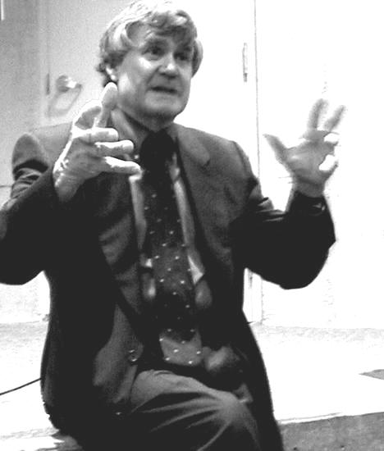
<rant>
According to [the] proponents [of new experimentalism], experiment can have a “life of its own” inde- pendent of a large-scale theory.
Ian Hacking (1983) Representing and Intervening
</rant>
Notes:
Experimentation is not second class activity!
Faraday’s motor

Slide 3
<rant>
Relevant case study
Look at non-trivial real-world problem
Theory or language independent
Produce significant visible result
Combination of language features
Arising from the ML tradition
</rant>

Slide 4
Demo Doing web-based data analytics with F#

Slide 5
How does this work?
Type providers
Meta-programming
ML type inference
Async workflows

Slide 6
Meta-programming
Meta-programming
Light-weight meta-programming
Pick one aspect and do it well
Heterogeneous execution (CUDA, SQL, JS, …)
Implicit and explicit quotations
[<ReflectedDefinition>]
module Program
D. Syme. Leveraging .NET meta-programming components from F#, ML workshop 2006

Slide 7
JavaScript integration
Meta-programming
F# to JavaScript translation
F# semantics or JavaScript semantics?
F# libraries or JavaScript libraries?
TypeScript type provider
type j = TypeScript.Api<"jquery.d.ts">
type h = TypeScript.Api<"highcharts.d.ts">
T. Petricek. Client-side scripting using meta-programming. BSc thesis. Charles University, 2007

Slide 8
Asynchronous workflows
Async workflows
Single-threaded semantics
Close to F# GUI threading model
Syntax matters!
let render () = async {
let opts = h.HighchartsOptions()
for country, check in infos do
let! data = country.Indicators.
``School enrollment (% gross)`` (* ... *) }
D. Syme, T. Petricek, D. Lomov, The F# Asyn-chronous Programming Model, PADL 2011
T. Petricek, D. Syme. The F# Computation Expression Zoo, PADL 2014

Slide 9
Type providers
Type providers
Data access
Source-specific vs. general-purpose providers
Language and platform integration
type WorldBank = WorldBankProvider<Asynchronous = true>
let data = WorldBank.GetDataContext()
let countries = [ data.Countries.Sweden; ... ]
type j = TypeScript.Api<"jquery.d.ts">
D. Syme et al. Themes in Information-Rich Functional Programming for Internet-Scale Data Sources, DDFP 2013

Slide 10
Not your grandma’s type safety
ML type system has its merits here…
…just different than you thought!
Invaluable when writing code
Safety guarantees still exist
Well-typed programs don’t go wrong?
Handling data-source changes (help?)
Importing unsound types (blame?)

Slide 11
Design considerations
Orthogonal design
Async workflows, type providers, meta-programming
Independent features, play well together
What can be in the library
All minimal syntactic extensions
Prefer library without making code ugly
Type providers, computation expressions, quotations

Slide 12
Conclusions
We need more case studies!
one + one ≥ two
Type safety is relative
ML-style languages are nice!
Get in touch: tomas@tomasp.net | @tomaspetricek | @dsyme
Read my rant: http://tomasp.net/academic/papers/philosophy-pl

